Slide 1
Motion
Motion and Objects

Slide 2
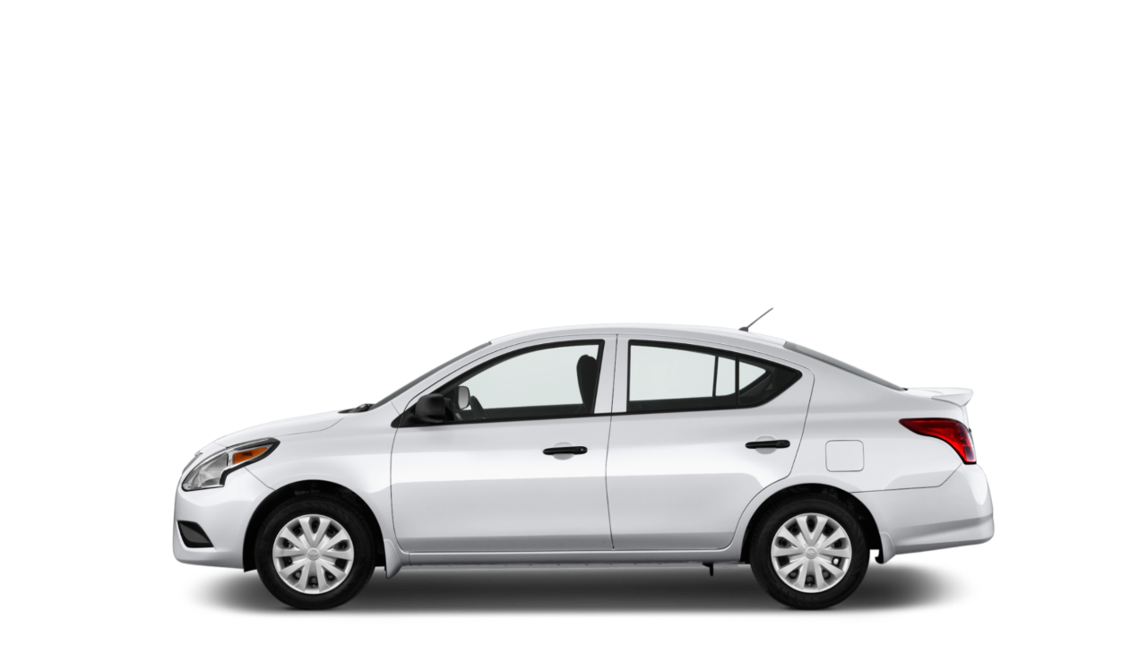

Slide 3

SPEED

Slide 5
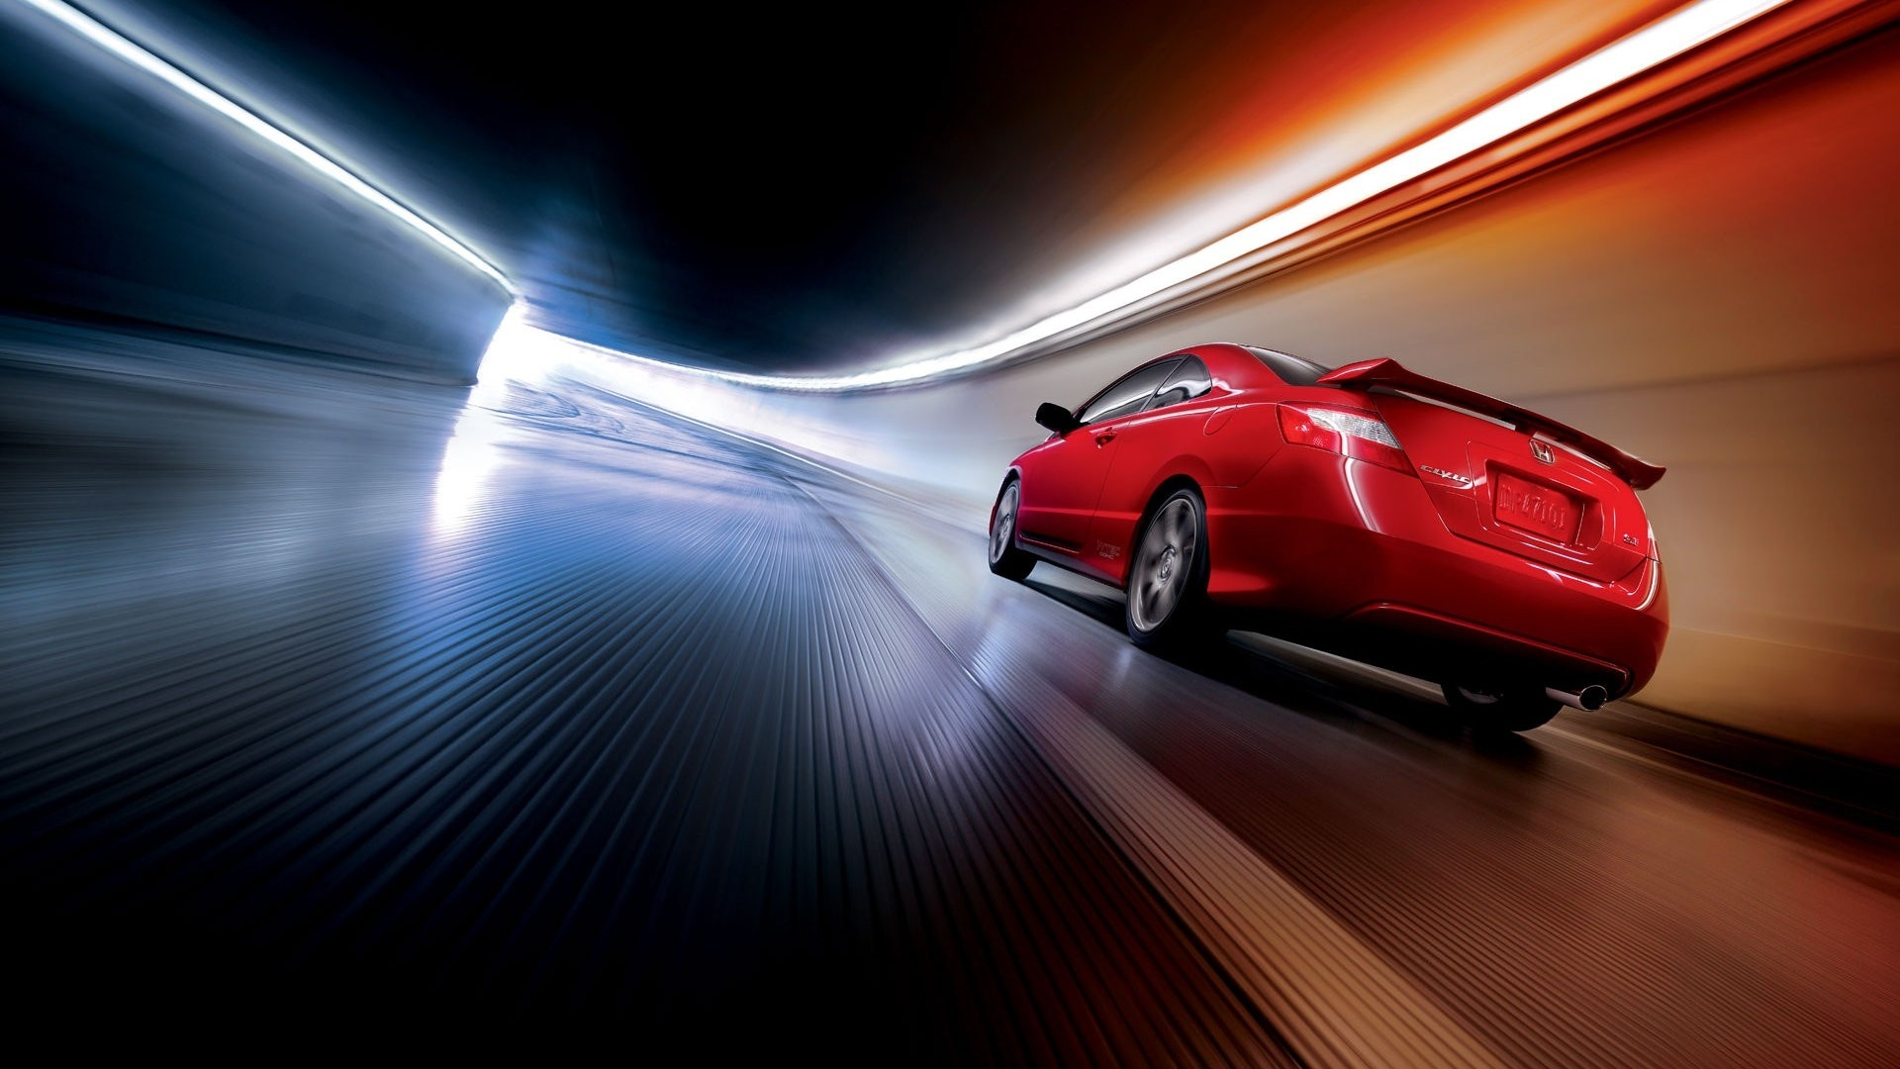

Slide 6

30 MPH

Slide 7
HEADING
DIRECTION
30 MPH

Slide 8
Vector (Heading)
speed / magnitude
y speed
x speed

Slide 9
The Numbers So Far (4)
Position: X and Y
Speed: X and Y
y speed
x speed

Slide 10
Let’s Code It
https://editor.p5js.org/crhallberg/sketches

Slide 11
Two Problems – Two Solutions
Ball doesn’t stop. – Conditionals!
That’s a lot of variables for one ball. – Objects!

Slide 12
negative xSpeed
positive xSpeed

Slide 13
if (xPos > width) {
xSpeed = -xSpeed;
}

Slide 14
Try It Yourself

Slide 15
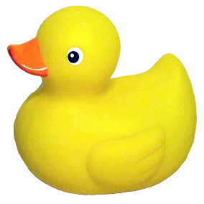
Pseudocode
Make variables for circle (position, speed)
Forever in draw:
Background
Draw the circle
Add speed to position
If we hit the right edge (width):
Bounce
If we hit the left edge (0):
Bounce
Notes:
Take a break?

Slide 16
Two Problems – Two Solutions
Ball doesn’t stop. – Conditionals!
That’s a lot of variables for one ball. – Objects!

Slide 17
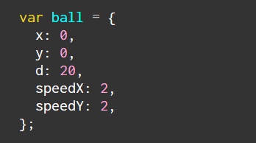
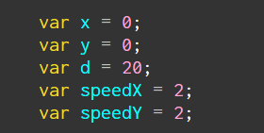
Objects

Slide 18
Homework
Posted on Canvas

Slide 19
Gravity
position
speed

Slide 20
Gravity
position
speed
acceleration

Slide 21
Gravity
position
speed
acceleration

